Slide 1
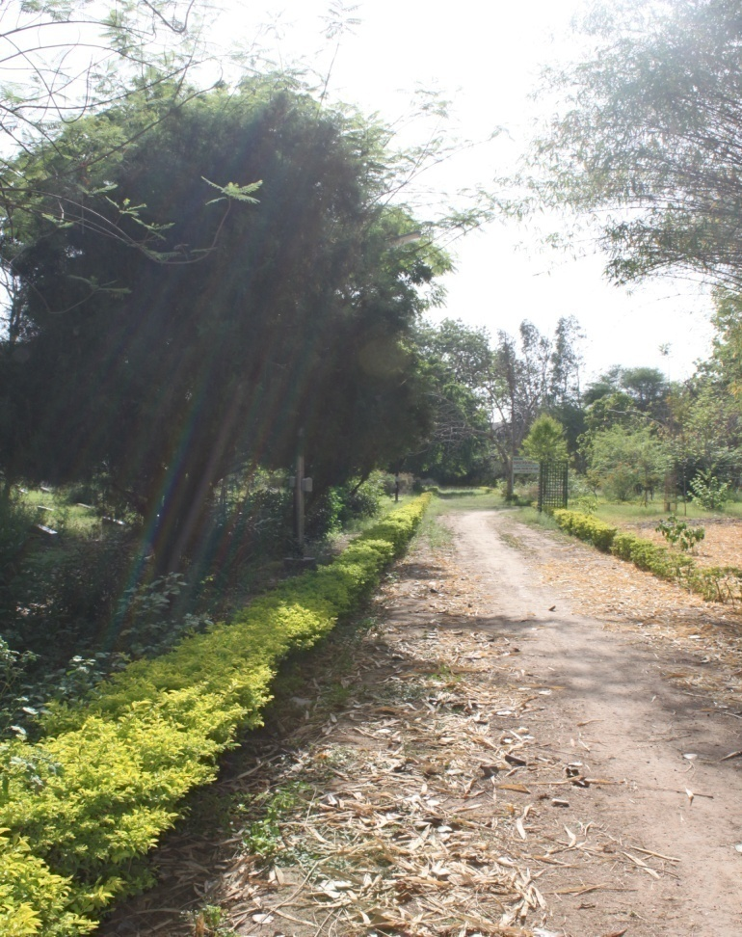
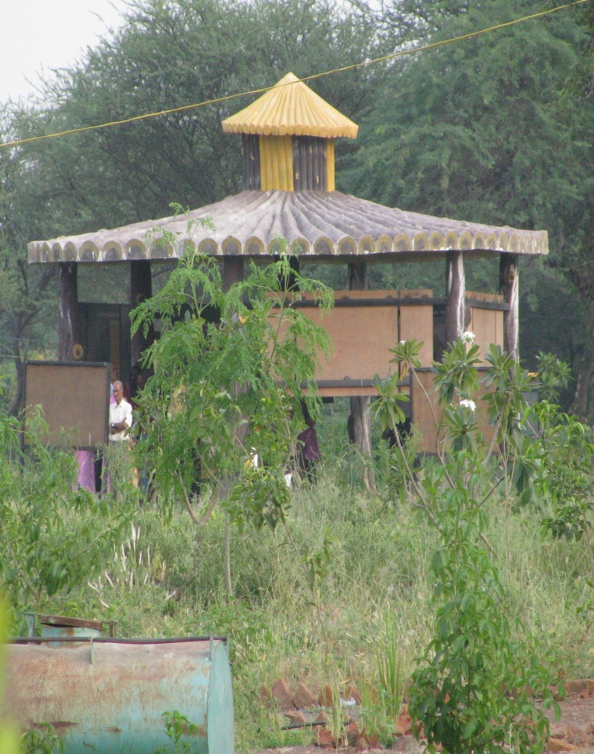
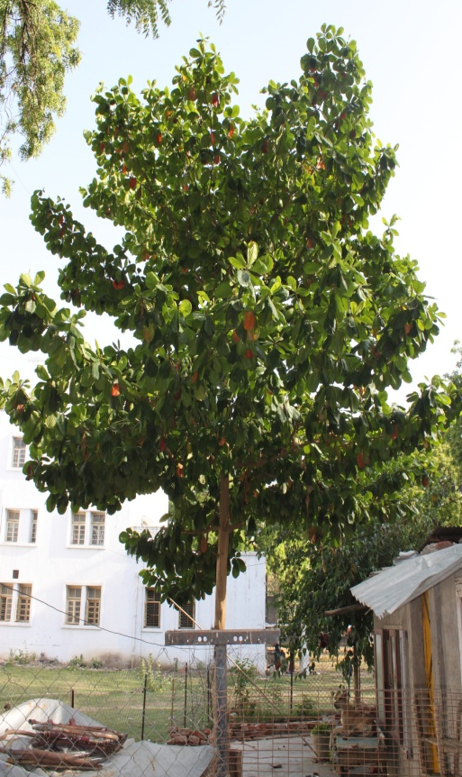
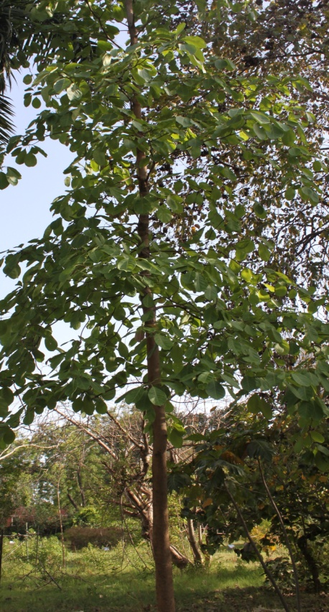
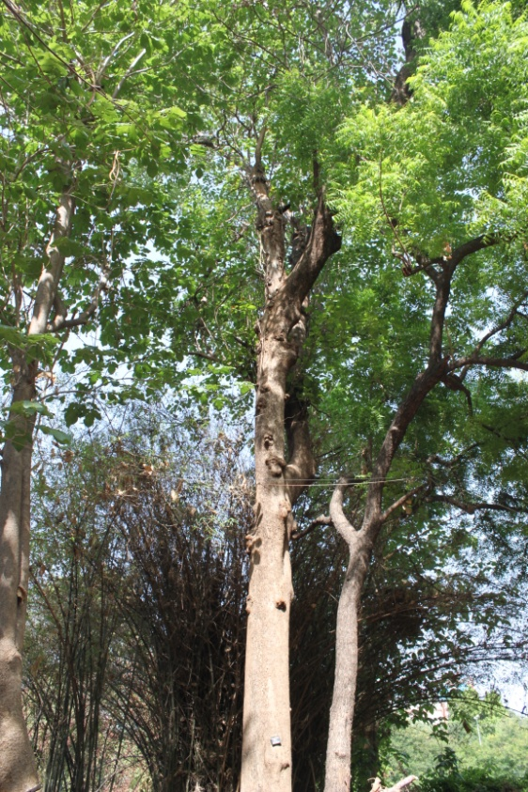
SURVEY
PLATE I
A
B
C
D
E

Slide 2
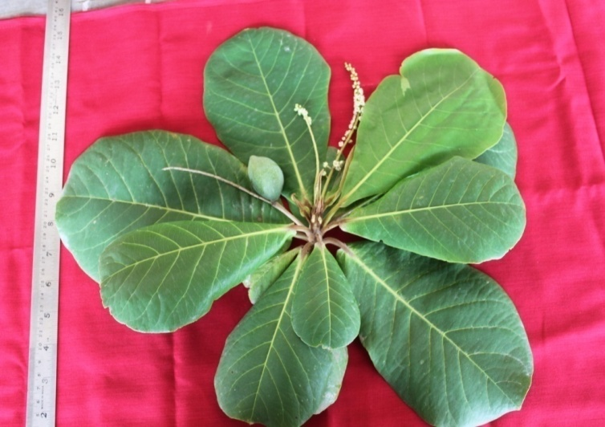
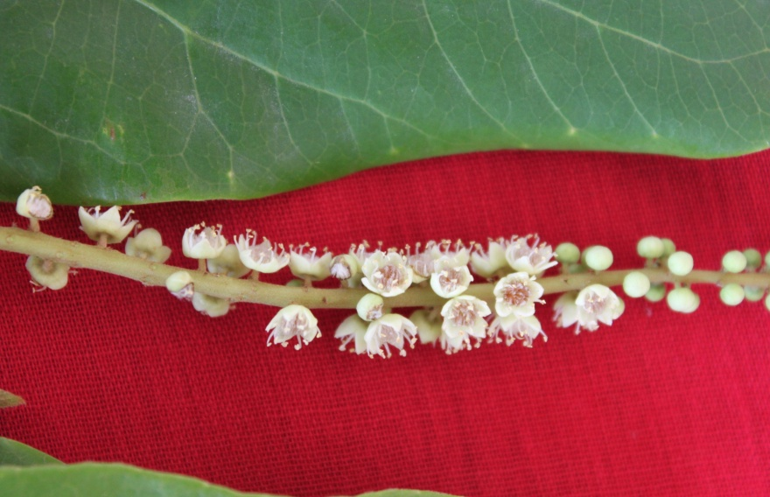
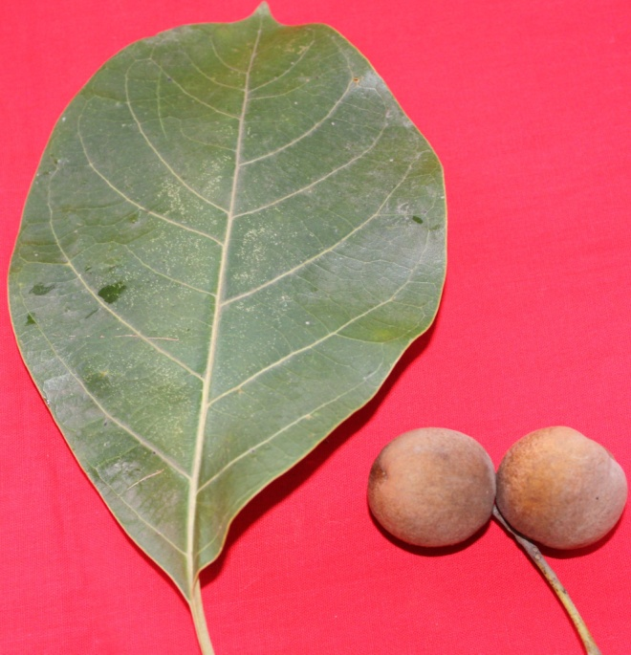
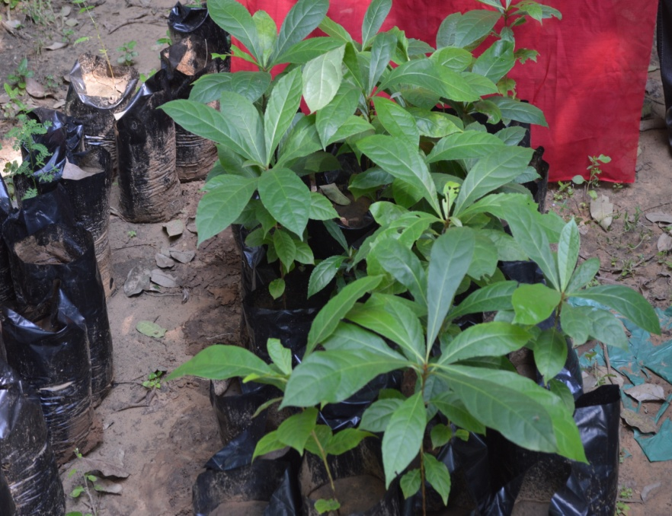
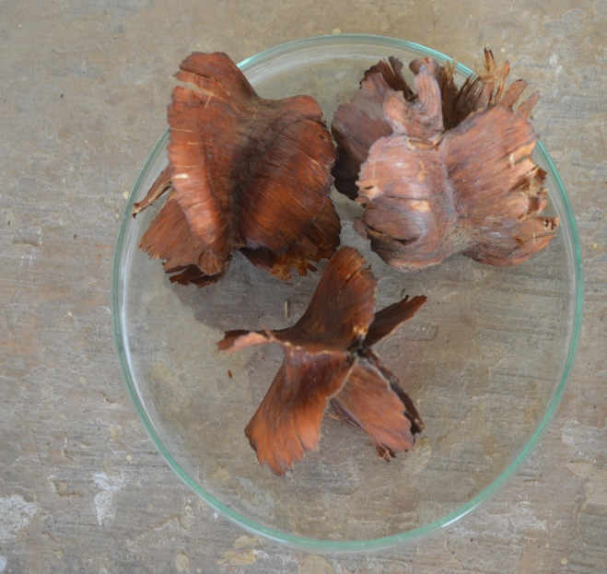
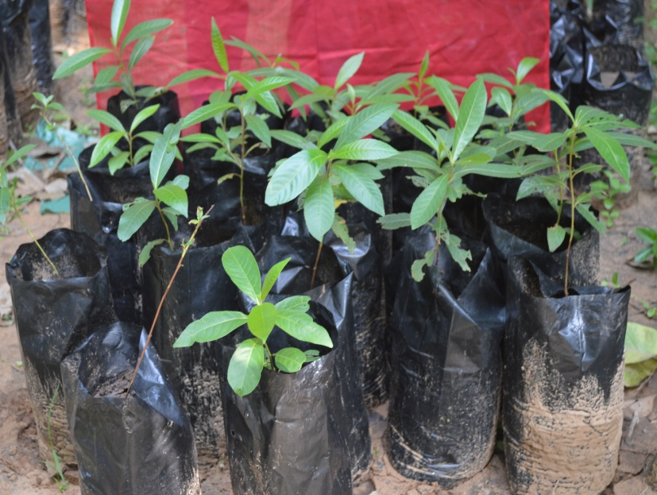
PLATE II
A
B
C
D
E
F

Slide 3
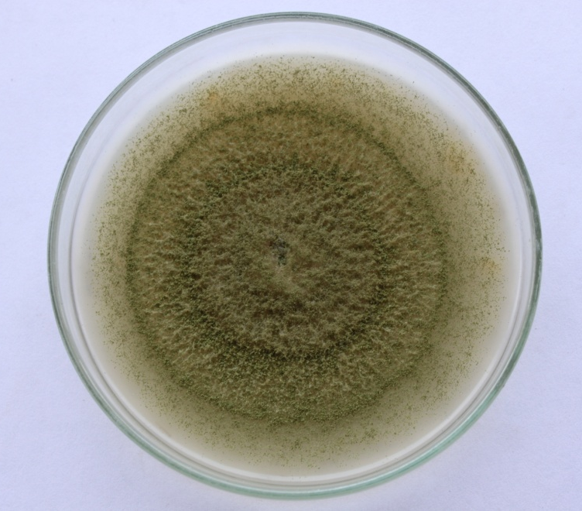
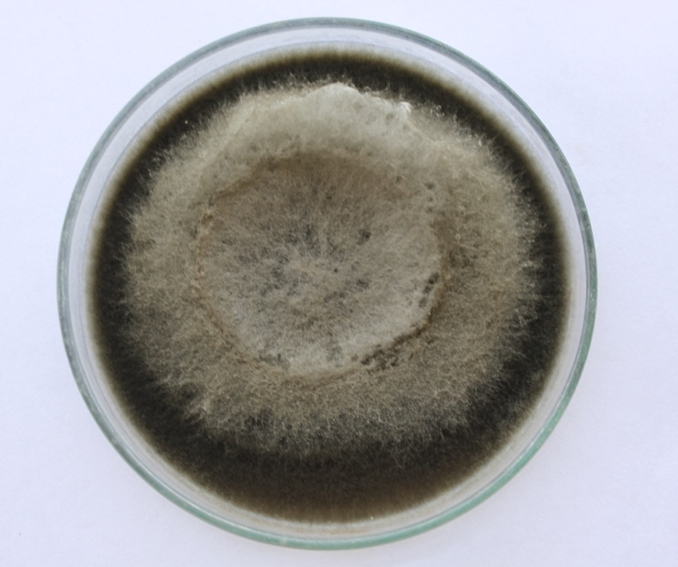
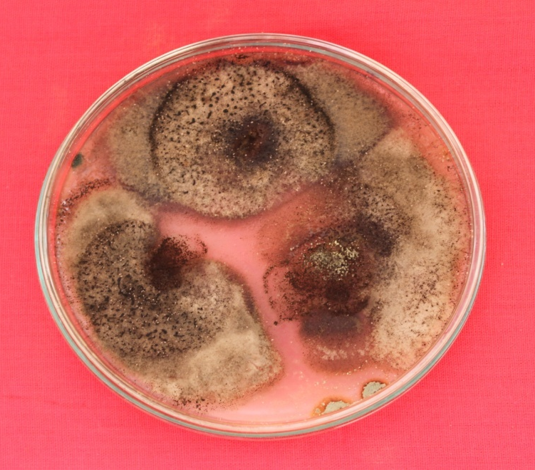
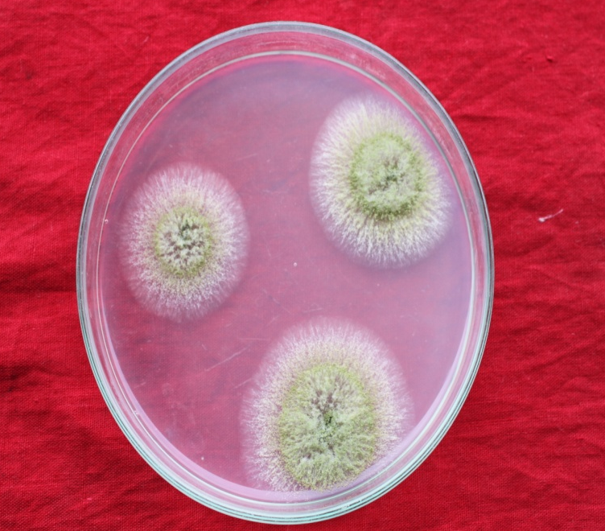
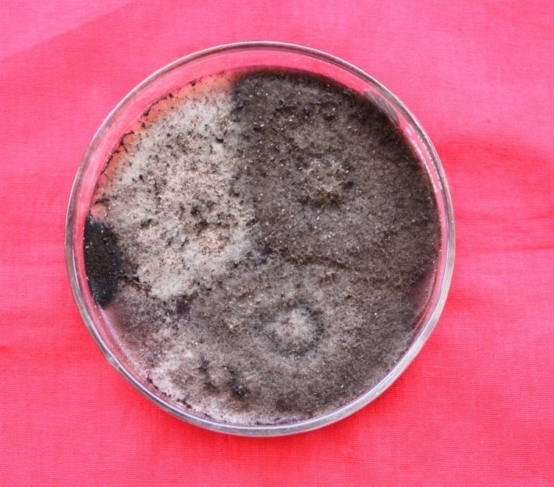
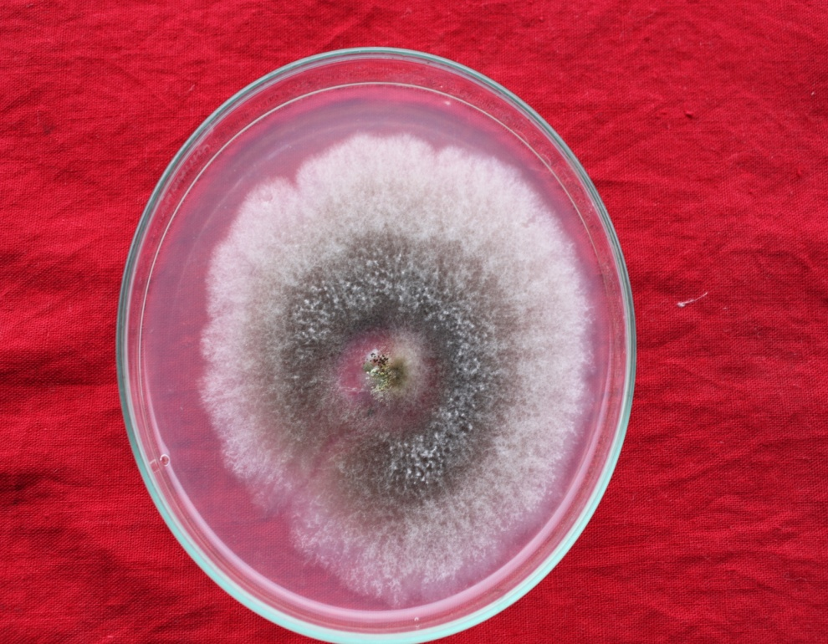
Fungi isolated
PLATE III
A
B
C
D
E
F

Slide 4
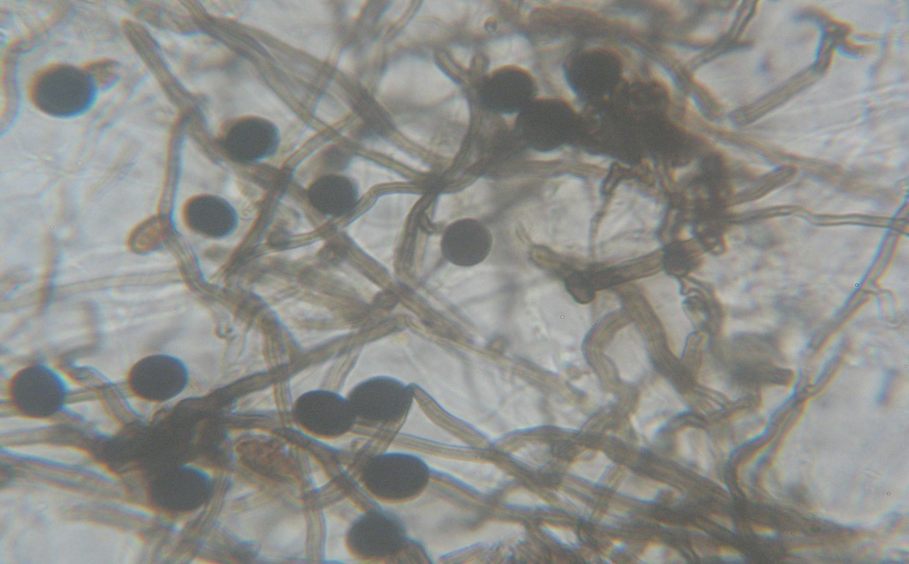
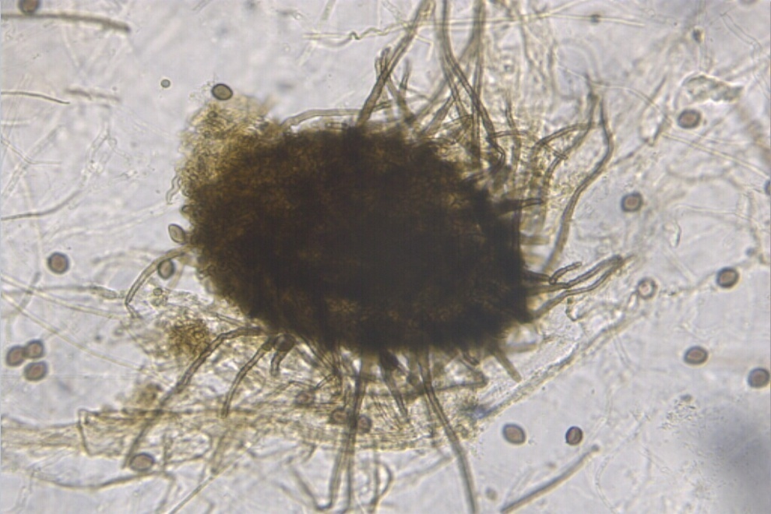
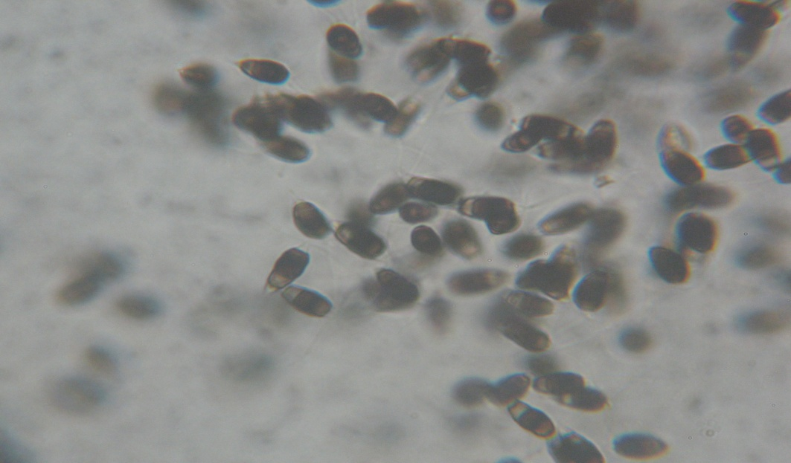
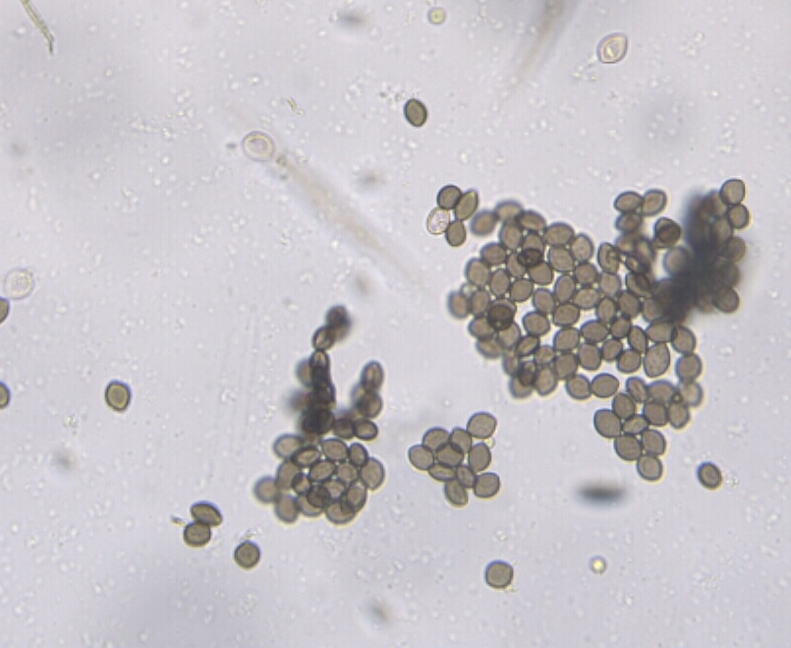
Fungi identified
PLATE IV
A
B
C
D

Slide 5
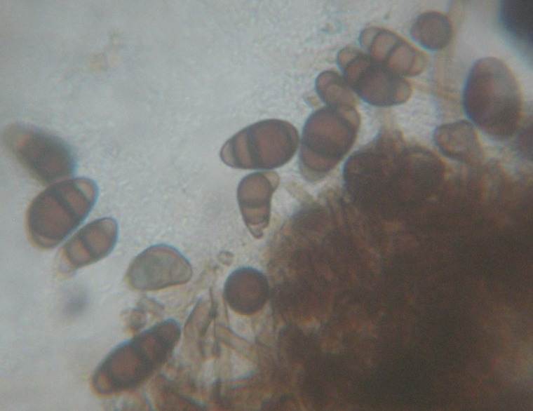
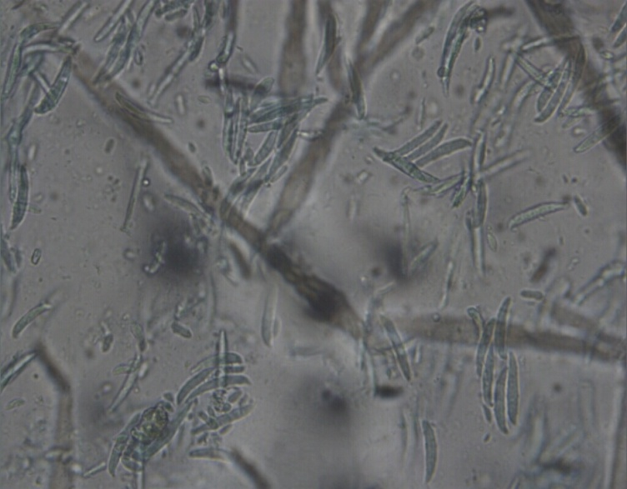
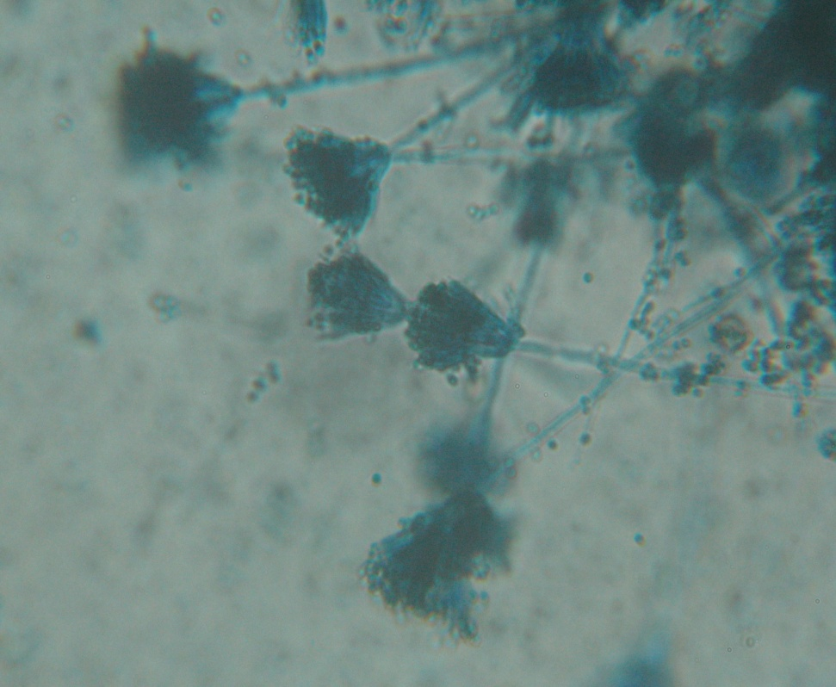
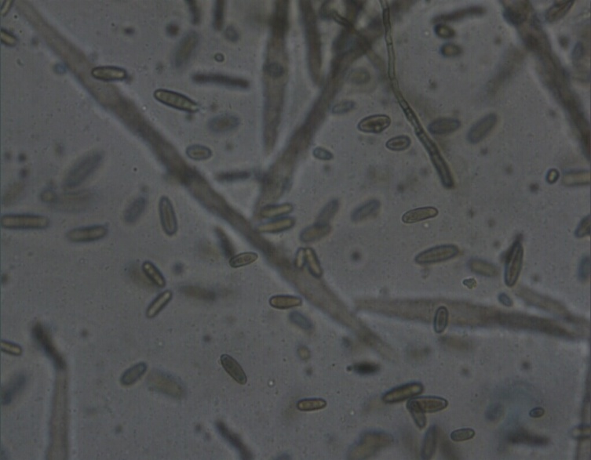
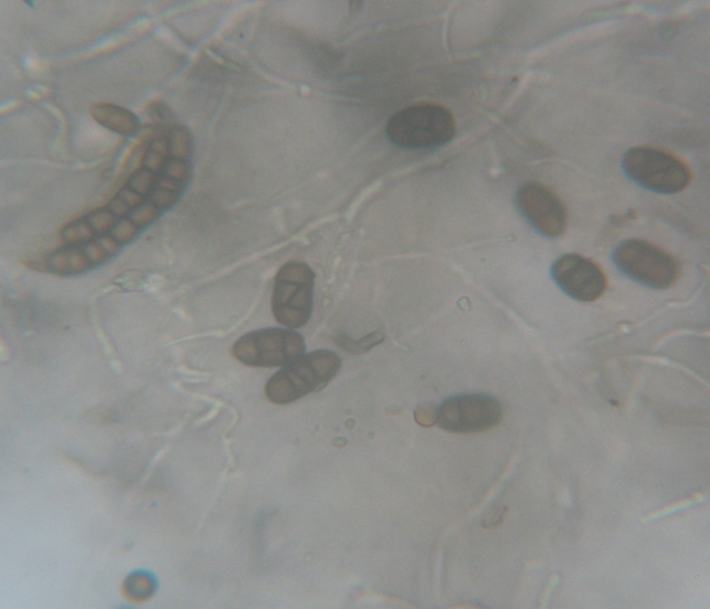
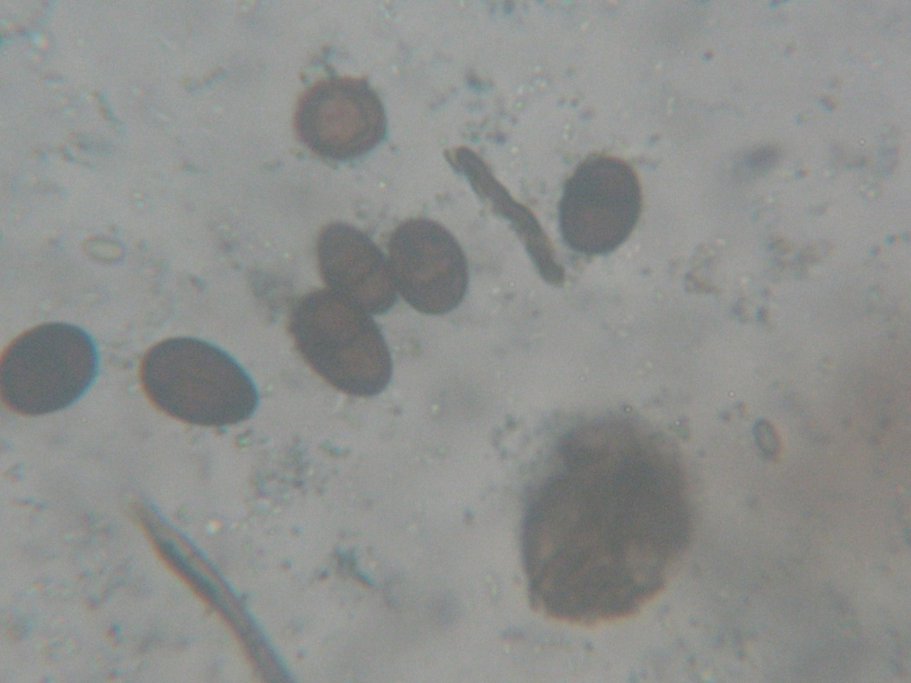
PLATE V
A
B
C
D
E
F

Slide 6
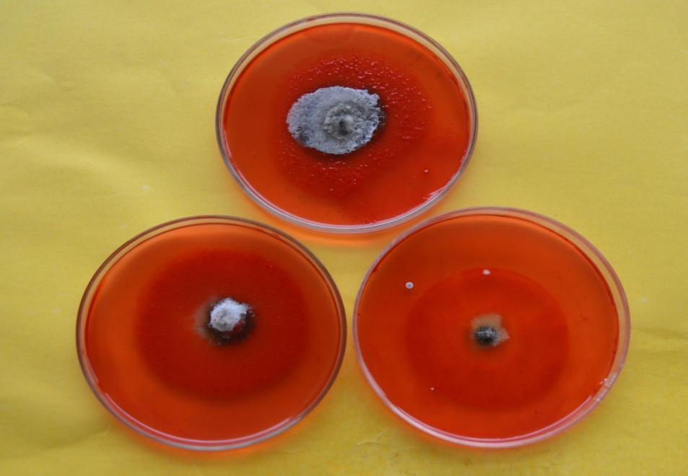
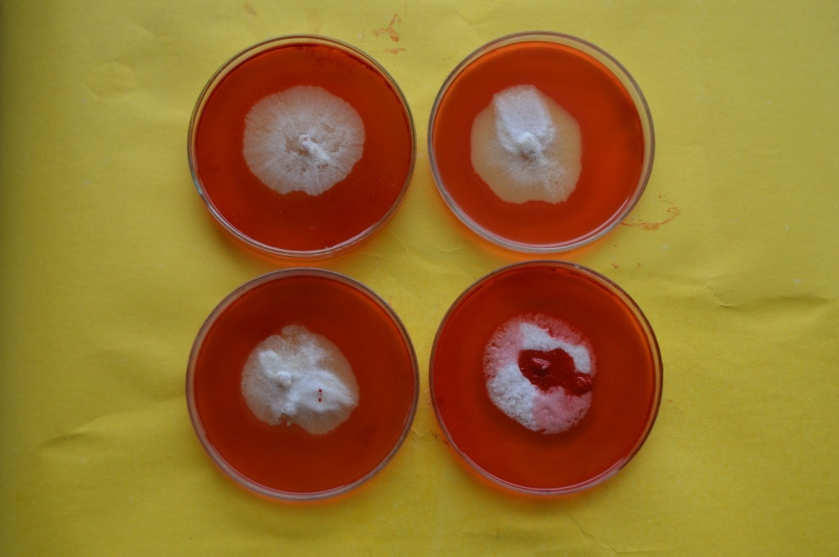
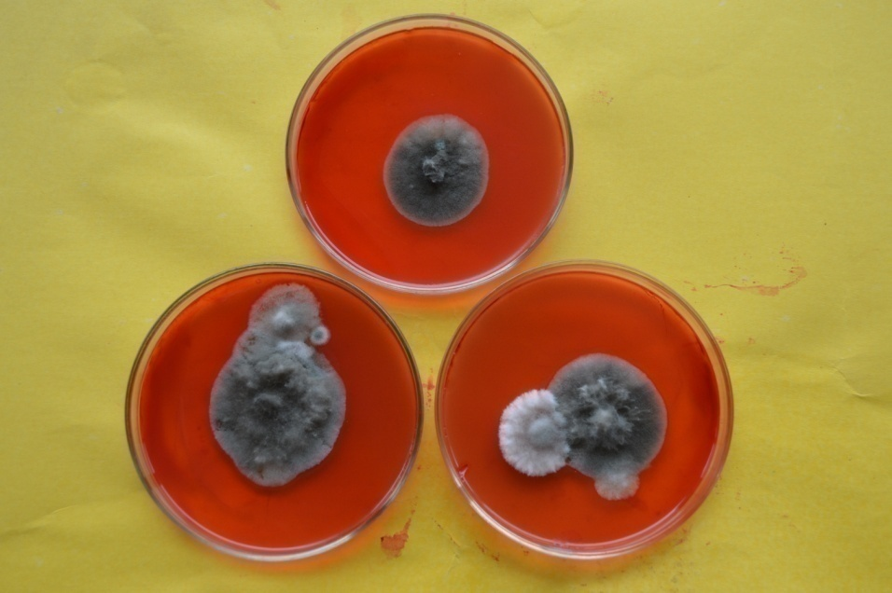
Screening of Cellulolytic activity
PLATE VI
A
B
C

Slide 7
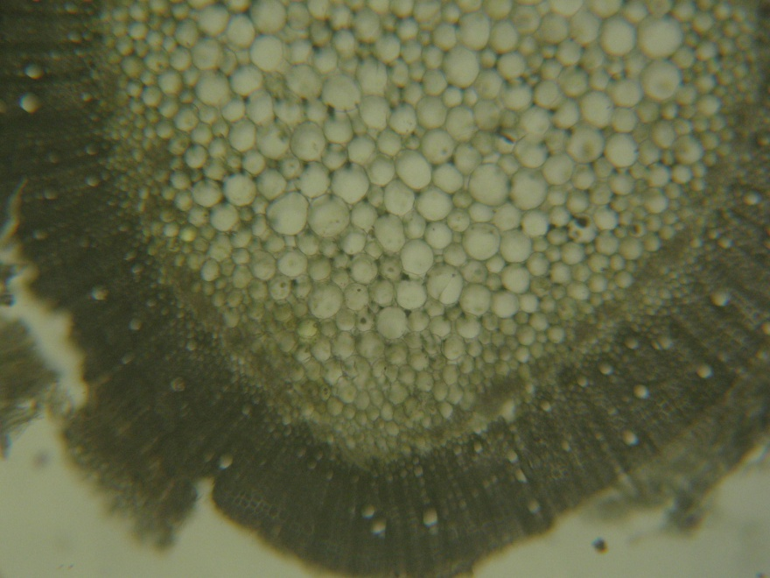
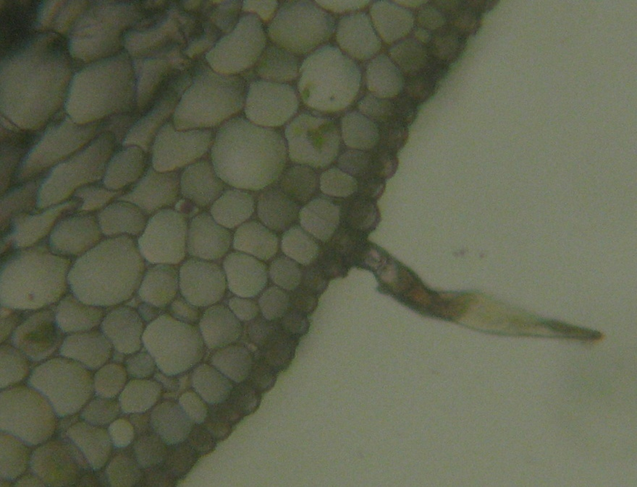
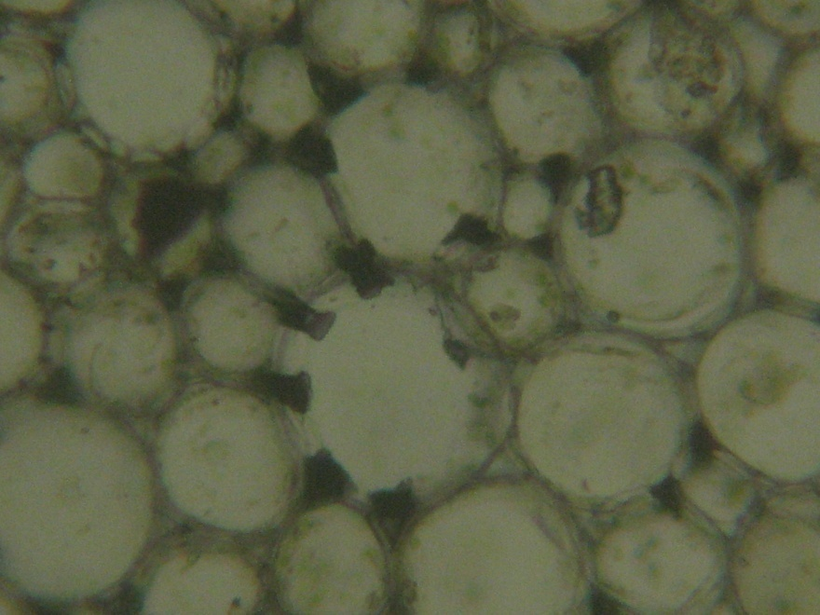
Anatomical Studies
PLATE VII
A
B
C

Slide 8
Illustration of Photographs
Plate I
Fig. A Botanical garden, The Maharaja Sayajirao University of Baroda
Fig. B Photograph of Virasat Van, Halol
Fig. C Tree of Terminalia catappa
Fig. D Tree of Terminalia bellerica (Gaertn.) Roxb,
Fig. E Plant of Terminalia arjuna (Roxb.) W. & A.
Plate II
Fig. A Leaves of Terminalia bellerica
Fig. B Flowers of Terminalia arjuna (Roxb.) W. & A.
Fig. C Leaf and fruit of Terminalia bellerica (Gaertn.) Roxb,
Fig. D Saplings of Terminalia bellerica (Gaertn.) Roxb,
Fig. E Fruits and F Young Plants of Terminalia arjuna (Roxb.) W. & A.
Plate IIII
Fig. A- F The Cultures of Endophytes grown in Petriplates
Plate IV
Fig. A. Photographs of conidia of Nigrospora sphaerica
Fig. B. Photographs of Perithecia and ascospores of Chaetomium
Fig. C. Photographs of conidia of Pestalotiopsis
Fig. D. Photographs of conidia of Lasiodiplodia theobromae
Plate V
Fig. A. Photographs of conidia of Curvularia lunata
Fig. B. Photographs of Conidia of Fusarium oxysporum
Fig. C. Photographs of conidia of Fusarium roseum
Fig. D. Photographs of conidia of Penicillium citrinum
Fig. E. Ulocladium chartarum (G Preuss) EG Simmons
Fig. F. Conidia of Lasiodiplodia theobromae

Slide 9
Plate VI
Fig. A. Photographs of conidia of Gloeosporium
Fig. B. Photographs of Conidia of Myrothecium roridum
Fig. C. Photographs of conidia of Chaetomium
Fig. D. Photographs of conidia of Aspergillus flavus
Fig. E. Photographs of conidia of Aspergillus niger
Fig. F. photograph of Conidia of Curvularia
Plate VII
Screening of Cellulolytic activity of different fungi
Plate VIII
Anatomical details of leaf and Petiole Sowing tissues

