Slide 1
SSBCOM-II MEIP UNIT-III
INFLATION & UNEMPLOYMENT
SESSION –I

Slide 2
INFLATION
In this Presentation:
Meaning & Definition of Inflation-- Types of Inflation (Rate-based & Cause based)--- Introducing Causes of Inflation / Theories of Inflation--- Process of Demand-Pull Inflation and Cost-Push Inflation--- Interaction of Demand-Pull and Cost-Push Inflation
References for this Section:
D.N. Dwivedi: Macroeconomics: Theory & Policy, 2001 Ed.
H.L. Ahuja: Macroeconomics: Theory & Policy, 19th Ed.
H. L. Ahuja: Macroeconomics: Theory & Policy, 20th Ed. (E-edition)

Slide 3
Inflation
In Next Presentation:
Monetarist and Structuralist Theories of Inflation (If Advised by Coordinator)

Slide 4
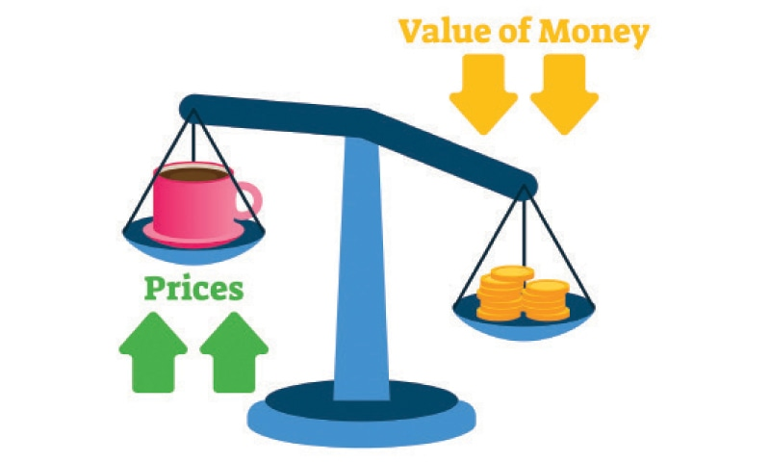
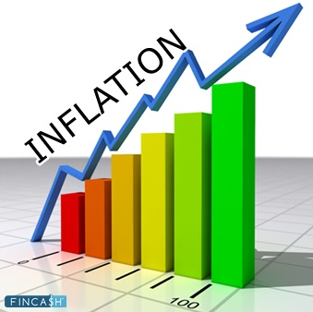
What is inflation?
Inflation refers to a considerable and persistent increase in the general price level.
By inflation we mean a persistent rise in the general price level over time, rather than a once-for-all rise in it.
Inflation is reflected in the sustained upward movement in some price index, such as the CPI, the WPI or the GDP deflator.
A price rise of 2–3 per cent per annum in the developed countries and 4–5 per cent per annum in the developing economies is generally considered as the desirable rate of inflation.

Slide 5
TYPES OF INFLATION: RATE-BASED CLASSIFICATION
Inflation is generally classified on the basis of its rate and causes.
Rate-based classification of inflation refers to the severity of inflation or how high or low it is.
Cause-based classification of inflation refers to the factors that cause inflation.
On the basis of rate of increase in the general price level, inflation is classified as follows.
Moderate inflation
Galloping inflation
Hyper-inflation, and
Open and Suppressed Inflation.

Slide 6
Moderate or “Creeping” Inflation
When the general level of price rises at a moderate rate over a long period of time, it is called moderate inflation or creeping inflation. In spite of inter-country variations, a single digit rate of annual inflation is called ‘moderate inflation’ or ‘creeping inflation.’ (<10 %)
It is predictable and generally acceptable by the people.
Galloping Inflation
Economists have different views on galloping inflation.
Baumol and Blinder define galloping inflation as an inflation that proceeds “at an exceptionally high rate.”
Again, Samuelson and Nordhaus define galloping inflation as inflation “in the double- or triple-digit range of 20, 100 or 200 per cent a year”.
But double and triple-digit inflation can range between 10 and 999 per cent, and the economic effects of inflation in this range will obviously be immensely different.

Slide 7
Classic cases of galloping inflation:
Post-First World War inflation in Germany (although some economists call it hyper-inflation). The wholesale prices in Germany had increased to a massive 4100 per cent in 1922. In 1923, prices had increased in Germany at an average rate of 500 per cent per month.
Argentina, Brazil, Mexico, Peru and Yugoslavia (former) experienced galloping inflation during the 1970s and 1980s.
These cases are also cited as the examples of hyper- inflation.

Slide 8
Hyper Inflation
The recent example of hyper-inflation is Venezuela, where the inflation rate as measured by Average Consumer Prices (Annual) was 65.37 thousand in 2019 and fell to 5.5 thousand in 2021 (IMF.org, 2021)
In general, a price rise at more than a three-digit rate per annum is called ‘hyper-inflation’. During hyper-inflation, paper currency becomes worthless and demand for money decreases drastically. Germany suffered from hyper-inflation in 1922 and 1923. As economists’ views go, there is not much difference between galloping inflation and hyper-inflation.

Slide 9
Open vs Suppressed Inflation
Open inflation is a situation where there is no control on rising prices. In the post-Second World War period, control and regulation of prices by direct and indirect measures was a common feature in most developed and developing economies.
In the modern world economy, open inflation is a rare phenomenon.
An example of suppressed inflation is India, where the 7–8 per cent inflation in 2008 was virtually a suppressed inflation. The current inflation rate in India rose to 5.52% as of March 2021.
INFLATION, DISINFLATION AND DEFLATION
We know that inflation refers to a considerable and persistent increase in the general price level. Disinflation means a decline in the rate of inflation. Deflation means a fall in the general price level below the base-year level.

Slide 10
What causes inflation?
Causes of Inflation
Theories of Inflation
The Classical View
To the Classical economists, the only cause of an increase in the aggregate demand and therefore, only cause of inflation, was an increase in money supply.
The Keynesian View
Keynes too, postulated that inflation is caused by increase in the aggregate demand. But, according to Keynes, the aggregate demand might increase because of increase in real factors.

Slide 11
What Causes Inflation?
Keynesian View:
Inflation can result when either consumption demand, investment demand, or government expenditure rises causing an increase in aggregate demand with unchanged aggregate supply.
This creates a demand-supply gap which Keynes called the ‘inflationary gap’.
This inflationary gap was the cause of inflation, according to Keynes.
In Keynes’s view, inflationary gap is the gap between the planned expenditure and the real output available at full employment.
Combine this discussion with Sir’s presentation of Infl Gap & DD-Cost Push.
Also cut out this Presentation drastically.

Slide 12
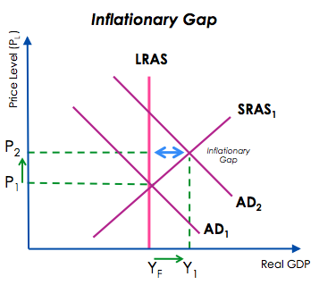
Inflationary Gap
Fig 1: Inflationary Gap

Slide 13
Demand-Pull and Cost-Push Inflation
The modern theory of inflation is a synthesis of Classical and Keynesian theories of inflation, showing that inflation is caused by both demand-side and supply-side factors.
The demand-driven inflation is called demand-pull inflation, while the supply-driven inflation is called cost-push inflation.
The two kinds of inflation, viz., Demand-pull inflation, and Cost-push inflation, both cause inflation independently, as well as interact and accelerate the inflation process.
Monetarist and Structuralist views
In addition, the Monetarist view of inflation, led principally by Milton Friedman, sees inflation as essentially an excess demand phenomenon caused by money and money alone.
The Structuralist view locates inflation, particularly in LDCs, in a number of structural rigidities and bottlenecks that impede supply of output.

Slide 14
Modern Monetary Theory (MMT)
And finally, as Mankiw (2020) points out, proponents of the Modern Monetary Theory (MMT) hold a somewhat different view of inflation,
Mainstream theories generally locate the cause of inflation in excessive growth in aggregate demand, while MMT proponents argue that “inflation gets out of control when workers and capitalists each struggle to claim a larger share of national income”. So, the solution to inflation, according to them, lies in incomes policies, such as government guidelines for wages and prices.
-------------------------------------------------------
N. Gregory Mankiw (2020): A Skeptic’s Guide to Modern Monetary Theory, Talk in AEA Meeting, January 2020

Slide 15
DEMAND-PULL INFLATION
As mentioned, demand-pull inflation represents a situation where inflation is caused by the pressure of aggregate demand for goods and services exceeding the available supply of output.
.Suppose in a situation of full employment, the government expenditure or private investment goes up. This generates an inflationary pressure in the economy.
Keynes explained that inflation arises when there occurs an inflationary gap in the economy which arises when aggregate demand for goods and services exceeds aggregate supply at full-employment level of output. In such a situation, naturally, the price level must rise.
Thus, demand-pull inflation is associated with the name of Keynes.
This imbalance between aggregate demand and supply may be the result of more than one force at work.

Slide 16
When aggregate demand for all purposes—consumption, investment and government expenditure—exceeds the supply of goods at current prices, there is a rise in price level.
Since inflation is a continuous increase in the price level, not a one-time rise in it, sustained inflation requires continuous increase in aggregate demand.
Illustration of Cause of Demand-pull inflation:
Let us assume the government adopts expansionary fiscal policy, that is, increases its expenditure, by borrowing from the Reserve Bank. This will lead to increase in aggregate demand (C + I + G).
If aggregate supply of output does not increase or increases by a relatively less amount in the short run, this will cause demand-supply imbalances which will lead to demand-pull inflation in the economy, that is, general rise in price level.

Slide 17
Similarly, inflation will result if business firms, expecting higher profits, invest more by borrowing from banks. Inflation will occur by this new investment demand if aggregate supply of output does not increase adequately in the short run.
Therefore, demand-pull inflation generally occurs when the economy is already working at full-employment level of resources (or at the “natural rate of unemployment”).
In the Indian context, owing to difficulty of measuring full-employment output, we use full capacity output of the economy beyond which supply of output cannot be increased.
Figure 2 depicts demand-pull inflation.

Slide 18
Demand-Pull Inflation
To depict demand-pull inflation, we must first distinguish between the long-run aggregate supply curve (LAS) and short-run aggregate supply curve (SAS), as in Fig. 2 below.
The long-run aggregate supply curve (LAS) is a vertical line drawn at the full-employment level or full-capacity output level.
The short-run aggregate supply curve SAS slopes upward to the right since more output will be supplied at a higher price because of diminishing returns to labour. The wage rate is constant.
Again, SAS slopes upward to the right even beyond full-employment or potential level of output, because even at full-employment level, some unemployment occurs due to frictional and structural factors and there is scope to increase employment.
Figure 2 below shows that the aggregate demand curve AD1 intersects the short-run aggregate supply curve SAS at point E1.

Slide 19
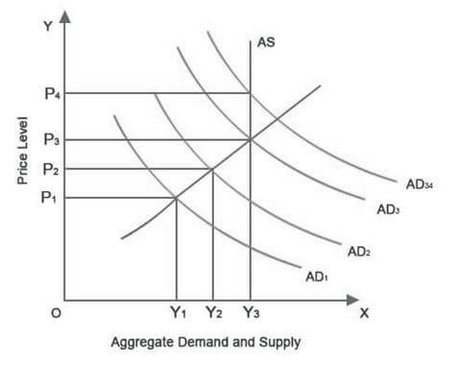
Demand-Pull Inflation
We begin at point E1 where the equilibrium between AD1 and SAS yields the output level Y1 and price level P1. Also, given LAS, the long-run full-employment (potential) GDP level is at Y3.
Now suppose without increasing taxes government increases its expenditure on goods and services and finances it through money financing from the Central Bank.
As government expenditure increases, aggregate demand curve shifts out to the right to AD2.
AD2 intersects the short-run aggregate supply curve SAS at point E2. As a result price level rises to P2 and real GDP to Y2.
Note that the price level has risen as a result of rightward shift in aggregate demand curve to AD2. Further increases in aggregate demand would result in a price level P3 and output Y3.
LAS
LAS
SAS
SAS
E3
E2
E1
Fig. 2: Demand Pull Inflation in Terms of AD-AS
Thus, in demand-pull inflation, the aggregate demand schedule is shifted up to the right. The price level rises because aggregate demand has increased relative to the aggregate supply, that is, due to demand-supply imbalances.
This is the most basic depiction of demand-pull inflation.

Slide 20
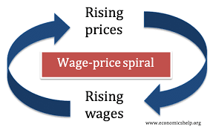
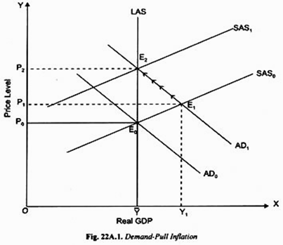
Demand-Pull and Wage Price Spiral
The story, however, does not end here if there is a wage-price spiral.
Wages remaining constant, as prices rise, workers’ real wages fall and workers demand higher wage rates.
This sets in motion a spiral of wage increase following each round of price increase.
Thus inflation occurs in a series of steps.
Interaction between demand-pull and cost-push inflation carries the process of inflation further and further.
3. Demand-Pull and Wage price Spiral

Slide 21
Demand-Pull Inflation Process and Continuous Sustained Rise in Price Level
Demand-pull inflation happens when for a given increase in aggregate demand, price level goes up to P2 as in Fig 2.
But, inflation is a continuous increase in the price level and not a one-time jump in prices in response to a given increase in aggregate demand.
Hence, for sustained or persistent inflation to take place the continuous increase in aggregate demand must occur, which can be due to any of the following:
Persistent increase in government budget deficit financed through money or debt financing year after year,
Or,
Persistent increase in money supply by the Central Bank, year after year.
Inflationary Expectations
An important cause of inflation is the expectations of future prices. Expectations play a significant role in decision-making by firms regarding price and output.
If a firm expects that its rival firms will raise their prices, it may also raise its own price in anticipation.
This is how inflationary expectations cause inflation. Case and Fair describe this as an “inflationary spiral.”
Therefore, to check inflation, the inflationary expectations have to be controlled.

Slide 22
COST-PUSH INFLATION
Even in situations where there is no increase in aggregate demand, prices may still rise.
This may happen if there is initial increase in costs independent of any increase in aggregate demand.
The four main autonomous increases in costs which generate cost-push inflation have been suggested:
1. Oil Price Shock
2. Farm Price Shock
3. Import Price Shock
4. Wage-Push Inflation
Cost-push inflation is also called supply-side inflation.
The most important difference between demand-pull inflation and cost-push inflation is that the former, caused by demand-side factors, causes an upward shift in the aggregate demand curve, causing both prices and output to rise (as long as the economy is below the potential level). On the other hand, cost-push inflation, arising from supply shocks, causes a leftward shift in the aggregate supply curve– leading to a rise in prices and a fall in the aggregate output.

Slide 23
COST-PUSH INFLATION (contd.)
Oil Price Shock.
During the seventies, and again in the 1990s and around 2008, cost-push inflation arose in all oil-importing countries due to supply-side shocks as crude oil prices were hiked by OPEC.
Again, in the recent years, oil prices have fluctuated quite a bit, rising above $100 per barrel in 2014 followed by a plunge below 20$ around April 2020.
Rise in oil prices not only causes inflation by raising cost of production, but also adversely affects the import bill and balance of payments of oil-importing countries such as India.
2. Farm Price Shock.
Cost-push inflation can also come about from increase in prices of other raw materials, especially farm products, in economies like India where they are of greater importance.
A related phenomenon is rise in food prices or food inflation.

Slide 24
COST-PUSH INFLATION (contd.)
3. Import Price Shock.
In the current regime of flexible exchange rates, currencies of most countries are determined by demand for and supply of a currency.
They can appreciate or depreciate frequently in terms of the US dollar.
A depreciation in the Indian rupee makes India’s imports costlier to both producers and consumers.
Thus depreciation of rupee causes import shock and cost-push inflation.
4. Wage-Push Inflation.
When powerful trade unions, especially in industrialized countries, push for higher wages unjustifiably either from productivity or cost of living aspects, they produce a cost-push effect.
In a situation of high demand and employment, employers are more likely to agree to wage increase as they can pass on these rises in costs to the consumers in the form of hike in prices.
If this happens we have cost-push inflation.
Also note that as a result of cost-push effect of higher wages, short-run aggregate supply curve of output shifts to the left and, given the aggregate demand, curve, results in higher price of output.

Slide 25
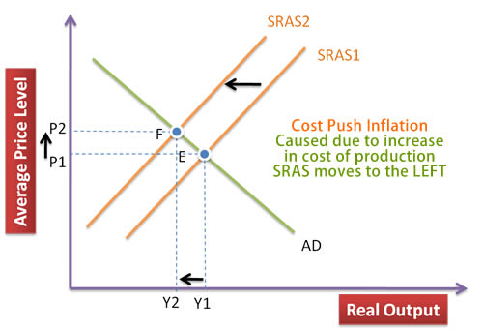
COST-PUSH INFLATION (contd.)
In Fig 3, aggregate supply and demand are measured along the X-axis and price level along the Y-axis. AD is the aggregate demand curve and SRAS1 is the initial aggregate supply curve.
Now consider a supply shock to the economy which causes the AS curve to shift upward to the left.
Given the upward shift in the aggregate supply curve from SRAS1 to SRAS2, price level rises from P1 to P2.
Simultaneously, output declines fromY1 to Y2 <Y1.
Thus, in this case when aggregate demand curve remains the same, price level rises due to rise in wages which has caused leftward shift in the supply curve.
An important feature of cost-push inflation is that this causes not only rise in price level but also brings about a fall in aggregate output. This situation of high inflation and lower output is generally described as stagflation, which famously gave rise to the genesis of the classic supply-side economics in the 1970s.
Fig 4: Cost-Push Inflation

Slide 26
COST-PUSH & DEMAND-PULL INFLATION: IDENTIFICATION PROBLEM & INTERACTION
In the real world, as many economists hold, observed sustained inflation is generally the result of the interaction between demand pull-and cost-push factors.
Was the inflation started in the first instance by cost-push or by demand-pull forces? Can we tell?
Economists hold that it is very difficult to identify the first cause, or first event that started the process of inflation.
However, demand-pull is typically considered to be the leading cause.
In the following analysis, we present a scheme to understand how cost push and demand pull forces interact to result in sustained inflation over time.

Slide 27
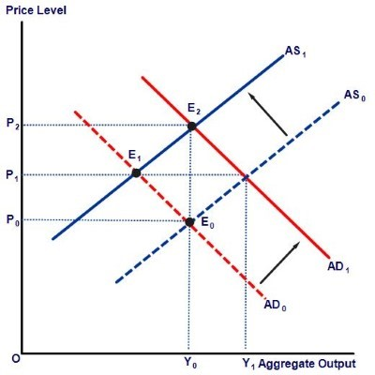
SPIRAL INTERACTION OF COST-PUSH & DEMAND-PULL INFLATION:
------------------------------------------------------
(Source image courtesy: Bajracharya (2018)).
The initial aggregate demand and aggregate supply curves AD0 and AS0 intersect at point E0. The initial equilibrium price level is P0 and output level Y0 (below the full-employment level).
Now suppose that due to a supply-shock e.g., an increase in input costs, the aggregate supply curve shifts leftwards to AS1.
As the aggregate demand schedule AD0 remains unchanged, this leftward shift in the supply curve causes prices to rise until equilibrium is reached at E1 at price level P1. Also, as this is a supply-side shock, aggregate output declines to Y’0.
As firms reduce their output and employment, workers become unemployed. To cure the depressionary situation, suppose the government undertakes expansionary fiscal policy through money financing.
As a result, demand expands and the aggregate demand curve shifts out to the right to AD1. Given the aggregate supply curve AS1, this creates excess demand at price P1. This pulls up the price level even further to P2. The final output is Y0 (higher than Y’0 but lower than Y1).
It is easy to see that if there is further shock to supply, and further increase in aggregate demand in turn, shifting both aggregate demand and supply curves in turn, then prices will rise even further and inflation will continue in a long-drawn out sequence. This is the spiral interaction of cost-push and demand-pull inflation.
Y’0
Fig. 4: Interaction between Cost-Push and
Demand-Pull Inflation

