Slide 1
SYBCOM
MEIP
UNIT-III
INFLATION & UNEMPLOYMENT
Section-III Phillips Curve

Slide 2
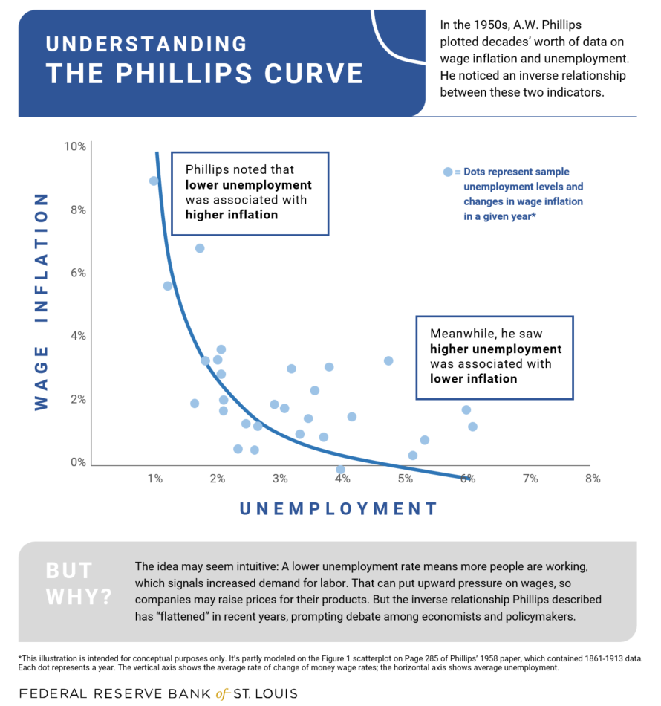
Phillips Curve
A famous inverse relationship (“trade-off”) between inflation and unemployment established in 1958 by A.W. Phillips, a British economist.
Phillips’ original observation was an inverse relationship between wage rate and unemployment (Mankiw 2003) based on historical data for about 100 years from the U.K economy.
A graphical plot of the historical data revealed an inverse relationship between wage inflation and unemployment.
The original Phillips Curve, as shown in figure 1.

Slide 3
Phillips Curve
In the modern Phillips curve used by economists today, price inflation is substituted for wage inflation. Also, the modern Phillips curve takes account of expected inflation as well as supply shocks (Mankiw 2003).
The original form of the Phillips Curve was of the form
y + a = bx^{c}
where y is the rate of change of wage rate, and x, the percentage unemployment.
Through “trial and error” the Phillips Curve equation was estimated as:
y + 0.900 = 9.638. x^{-1.394}
or, log (y+0.900) = 0.984 -- 1.394 log x

Slide 4
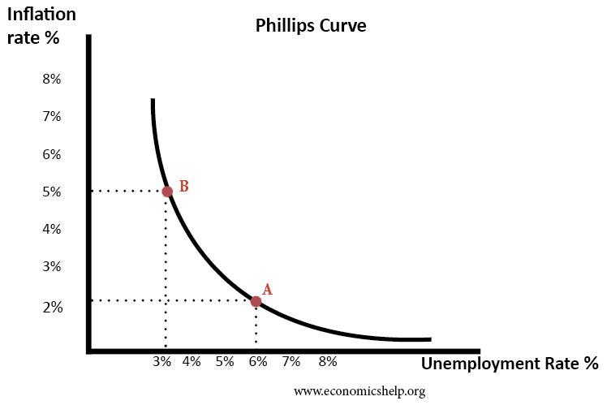
Fig. 2 shows the price Phillips curve, which measures unemployment rate along the horizontal axis and the rate of inflation along the vertical axis.
Thus when the rate of inflation is 5 per cent, the unemployment rate is 3 per cent.
When rate of inflation declines to 2 per cent, (if the government takes a contractionary fiscal policy and hence aggregate demand falls), the unemployment rate increases to 6 per cent.
Empirical data over the fifties and sixties for other developed countries seemed to confirm the Phillips curve.
Phillips Curve Showing Negative Relationship between Rates of Inflation and Unemployment .

Slide 5
Policy Implications of the Phillips Curve:
If the inverse relation between inflation and unemployment rate was stable, it would be highly challenging for economic policy makers.
Should they choose high employment which would mean high inflation, or a lower inflation which would mean higher unemployment?
In fact, as we discuss in a short while, the concept of a stable Philips Curve broke down during the seventies and eighties.

Slide 6
Explaining the Phillips Curve
Keynesian Explanation of Phillips Curve (Demand-Pull):
Both Keynesians and Monetarists agreed to the existence of the Phillips curve.
Keynesians explained the Phillips curve inflation-unemployment trade-off in terms of aggregate demand and upward-sloping aggregate supply curve.
Given diminishing returns to labour, and rising wage rate as employment increases, the Keynesian short-run aggregate supply curve is upward sloping as the economy approaches near full-employment level.

Slide 7
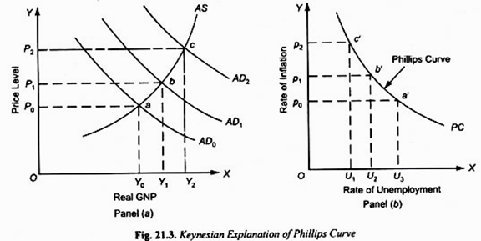
Phillips Curve: Keynesian Representation
In panel (a) of Fig. 3, as expansionary monetary policy keeps shifting the aggregate demand schedule from AD0 to AD1 and then to AD2, the equilibrium between AD and AS shifts from the price- output combinations (P0, Y0) to (P1, Y1) and to (P2, Y2) .
Now, increase in aggregate output means increase in employment of labour and therefore fall in unemployment rate. Hence, as price level rises from P0 to P1 to P2 (i.e., inflation occurs), unemployment falls.
The greater the increase in aggregate demand, the higher the rate of inflation and employment.
Panel (b) of Fig. 3 shows this inverse relationship between inflation rate and unemployment rate. It follows directly from panel (a), and gives us a downward-sloping Phillips curve PC.
Fig 3: Keynesian Explanation of Phillips Curve
“Thus, a higher rate of increase in aggregate demand and consequently a higher rate of rise in price level is associated with the lower rate of unemployment and vice versa. This is what is represented by Phillips curve”.
The trade-off became an important policy guide in the sixties.

Slide 8
Shifts in the Phillips Curve (USA 1971-91)
During the seventies there emerged a strange coexistence of a high rate of inflation side by side with high unemployment rate in the USA and Britain.
This phenomenon, now famously known as “stagflation”, suggested that the Phillips Curve relationship was either not invalid, or it was not stable.
Data from the US economy over the seventies and eighties suggested that instead of being stable, the Phillip curve had been shifting.
Causes of Shift in Phillips Curve
Keynesians’ Explanation: Adverse supply shocks.: In the 1970s, the OPEC countries steeply hiked oil and petroleum products prices, shifting the aggregate supply curve leftward.
This caused a higher price with reduced output and employment, and thus, a higher unemployment along with higher inflation.

Slide 9
Shifts in Phillips Curve
2. Friedman’s Refutation of a Stable Phillips Curve:.
In Friedman’s view, Phillips curve relationship was only a short-run trade-off.
In the long-run there was no such trade-off, and the Phillips Curve was vertical in the long-run.
“Keynesian expansionary fiscal and monetary policies were based on the wrong assumption of a stable Phillips curve and brought about increase in the rate of inflation”.
Friedman’s natural rate hypothesis
“Although there is trade-off between inflation and unemployment in the short run, in the long run the economy comes back to be in stable equilibrium at the natural rate of unemployment. The long-run Phillips curve is a vertical straight line”

Slide 10
Natural Rate of Unemployment:
Natural Rate of Unemployment (later termed NAIRU or Non-Accelerating-Inflation Rate of Unemployment) “… is the rate at which in the labour market the current number of unemployed is equal to the number of jobs available. These unemployed workers are not employed for the frictional and structural reasons, though the equivalent number of jobs are available for them.”
Both frictional and structurally unemployed constitute the natural rate of unemployment. Full employment is said to prevail even in the presence of this natural rate of unemployment.
For the developed countries, a 4 to 5 per cent rate of unemployment is taken as the natural rate of unemployment.

Slide 11
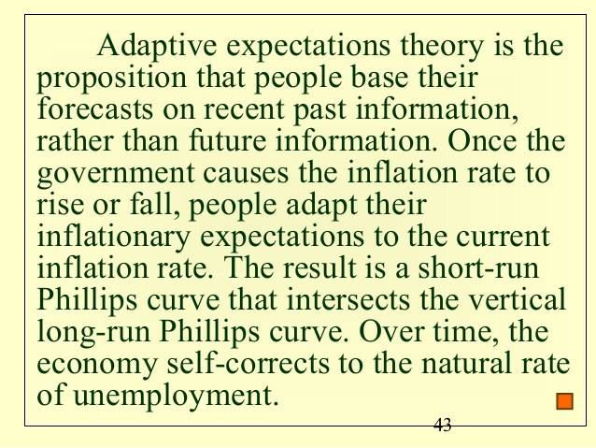
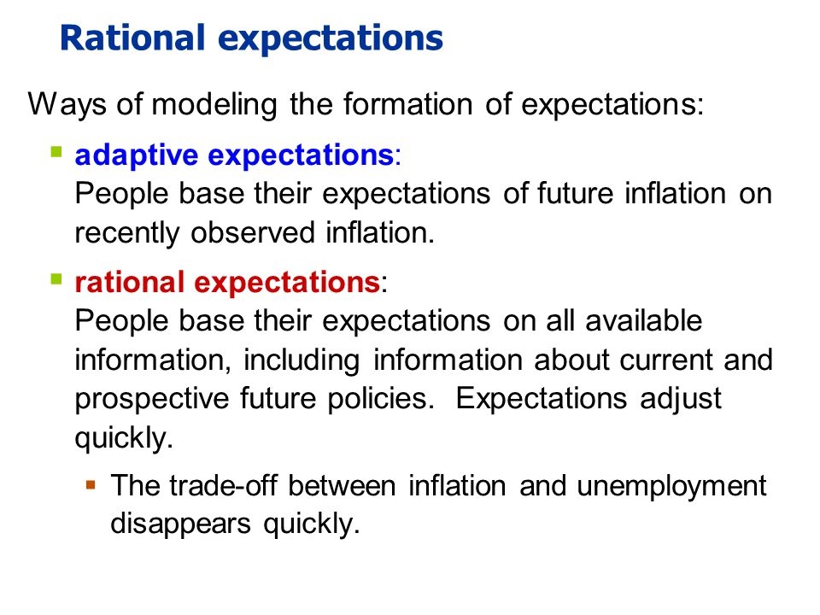
Phillips Curve, Adaptive Expectations and Natural Rate Hypothesis
Adaptive expectations: People form their expectations on the basis of previous period rate of inflation, and change or adapt their expectations only when the actual inflation turns out to be different from their expected rate. (Proposed by Fisher and later introduced by Friedman, Cagan et al)
In Friedman’s explanation of the short-run Phillips curve and its shifts, expectations about future inflation rate plays an important role .
When peoples’ expectations are adaptive, they look to the past level of inflation to form their price/ wage expectations and there is thus a time gap (lag) before they can adjust to current actual prices.

Slide 12
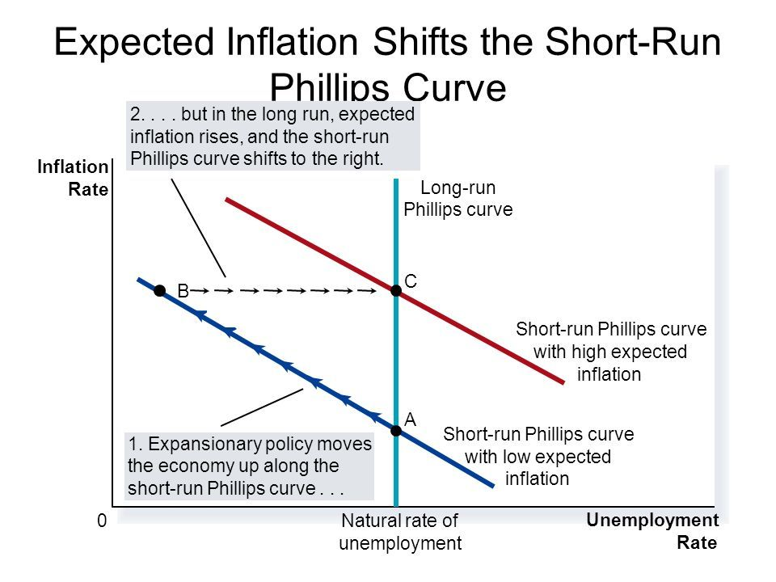
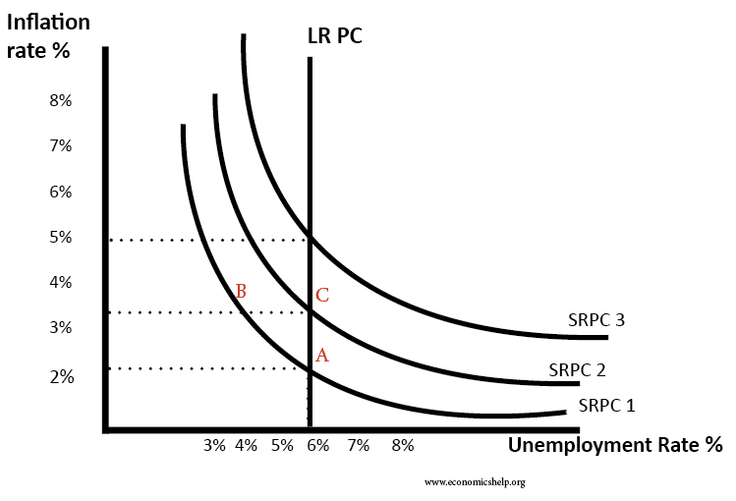
Shift in Short-run Phillips Curve and Long-run Phillips Curve.
If expectations are adaptive, the short-run Phillips Curve will be downward-sloping but will keep shifting until in the long-run, all adjustments have occurred.

Slide 13
Adaptive Expectations: Implications
“In the adaptive expectations theory of the natural rate hypothesis, the short run Phillips curve is downward sloping indicating a trade-off between inflation and unemployment rate in the short run.”
But “the long-run Phillips curve is a vertical straight line, showing that no trade-off exists between inflation and unemployment in the long run”.
Also, according to the adaptive expectations theory, “any rate of inflation can occur in the long run with the natural rate of unemployment”.

Slide 14
LONG-RUN PHILLIPS CURVE : RATIONAL EXPECTATIONS
A second explanation of the long-run Phillips Curve was provided by the Rational Expectations Hypothesis (Lucas, and Sargent & Wallace): which rests on two basic elements.
First, economic agents use all the available relevant information to correctly anticipate the effects of the Government’s economic policies and take correct decisions.
Secondly, like the classical economists, Rational Expectations assumes highly competitive product and factor markets, and as a result, highly flexible wages and product prices. Economic agents quickly absorb new information and new equilibrium prices immediately adjust to changes.
In Friedman’s adaptive expectations theory, nominal wages adjust to changes in the price level only with a time gap. Hence, in the short-run, business profits would rise, firms would expand output and employment in the short run, and unemployment would fall below the natural rate.
However, the rational expectations theory denies any such time lag. Rather, nominal wages are “quickly adjusted to any expected changes in the price level”. This means that the Phillips curve trade-off between rates of inflation and unemployment does not exist.

Slide 15
The rational expectations theory argues that when aggregate demand increases, there would not be any fall in unemployment.
This is because workers and businesses fully and correctly anticipate the inflation resulting and incorporate it quickly into the wage agreements.
Thus, it is the price level that rises, leaving the level of real output and employment unchanged at the natural level.
Thus, the rational expectations theory suggests that,
First, given resources and technology, the aggregate supply curve is a vertical straight line at the potential GNP level, that is, at the natural rate of unemployment.
Secondly, “The Long-run Phillips curve corresponds to this long-run aggregate supply curve and is a vertical straight line at the natural unemployment rate.”

Slide 16
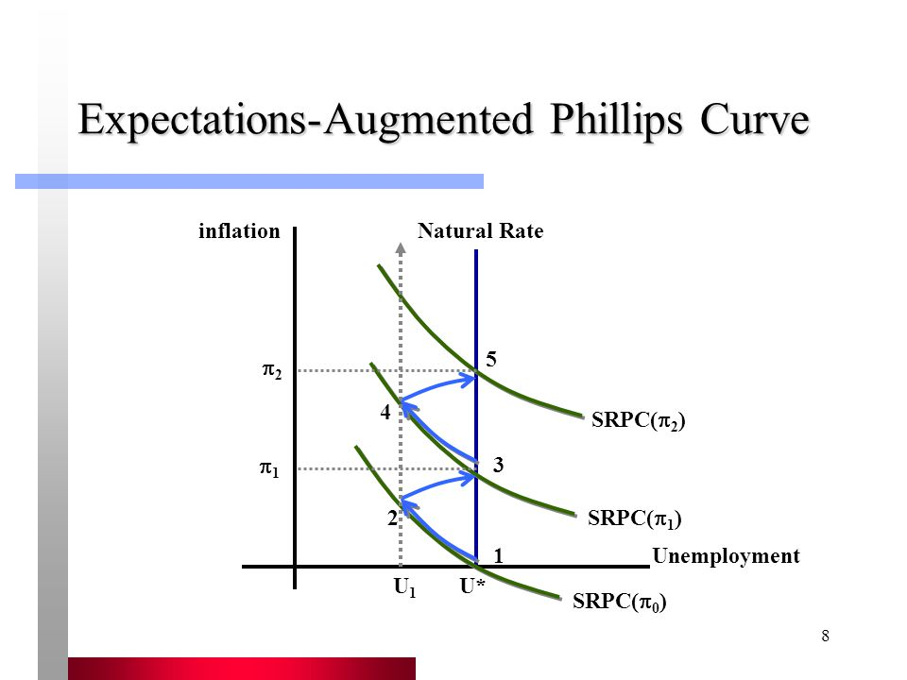
The Long-Run Phillips Curve: Rational Expectations
Rational Expectations Theory: the Long- run Phillips Curve is a Vertical Straight Line at the Natural Rate of Unemployment

Slide 17
Rational Expectations and Policy Ineffectiveness
If the Phillips Curve was downward sloping, that is, there indeed existed a trade-off between inflation and unemployment, then expansionary fiscal or monetary policy would be highly effective in solving unemployment.
On the other hand, if the Rational Expectations Hypothesis holds, such policy would be ineffective.
Why? Because if expectations are rational, then even if the government adopts expansionary monetary policy, the economy does not move temporarily to a short-run equilibrium, as it would do when expectations are adaptive.
Instead, people would correctly anticipate that this expansionary policy will cause inflation in the economy.
Hence, wages, product prices and the rate of interest all adjust to the expected inflation.
So that, investment, real output and employment level all remain unchanged.

Slide 18
Rational Expectations and Policy Ineffectiveness
Thus when people have rational expectations, their actions would frustrate any policy attempts to raise output and employment.
However, economists are divided on the policy ineffectiveness theorem, and they agree that expansionary policy could be effective if it was unanticipated.

Slide 19
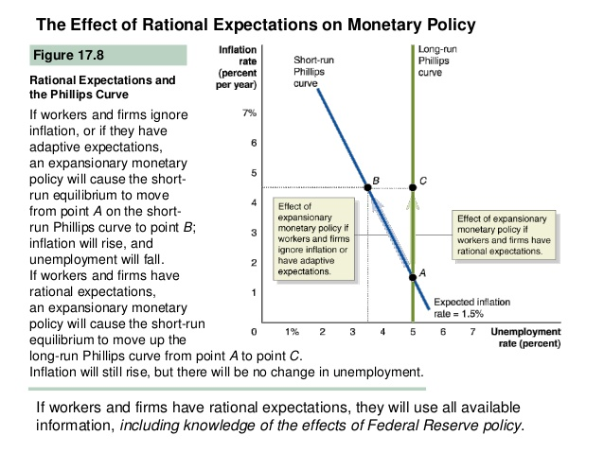
Rational Expectations and Policy Ineffectiveness
Figure: 7
monetary policy.

Slide 20
References:
H.L. Ahuja (2020): Macroeconomics: Theory and Policy, 20th ed. (E-edition)
D. N. Dwivedi (2001): Macroeconomics: Theory and Policy.
N. Gregory Mankiw (2003): Macroeconomics, 5th edition

